Slide 1
Audio/Bumpbot
ECE-1001
Team: Kit #15
Member #1 - Barak Barclay
Member #2 - Jasen Curtis

Slide 2
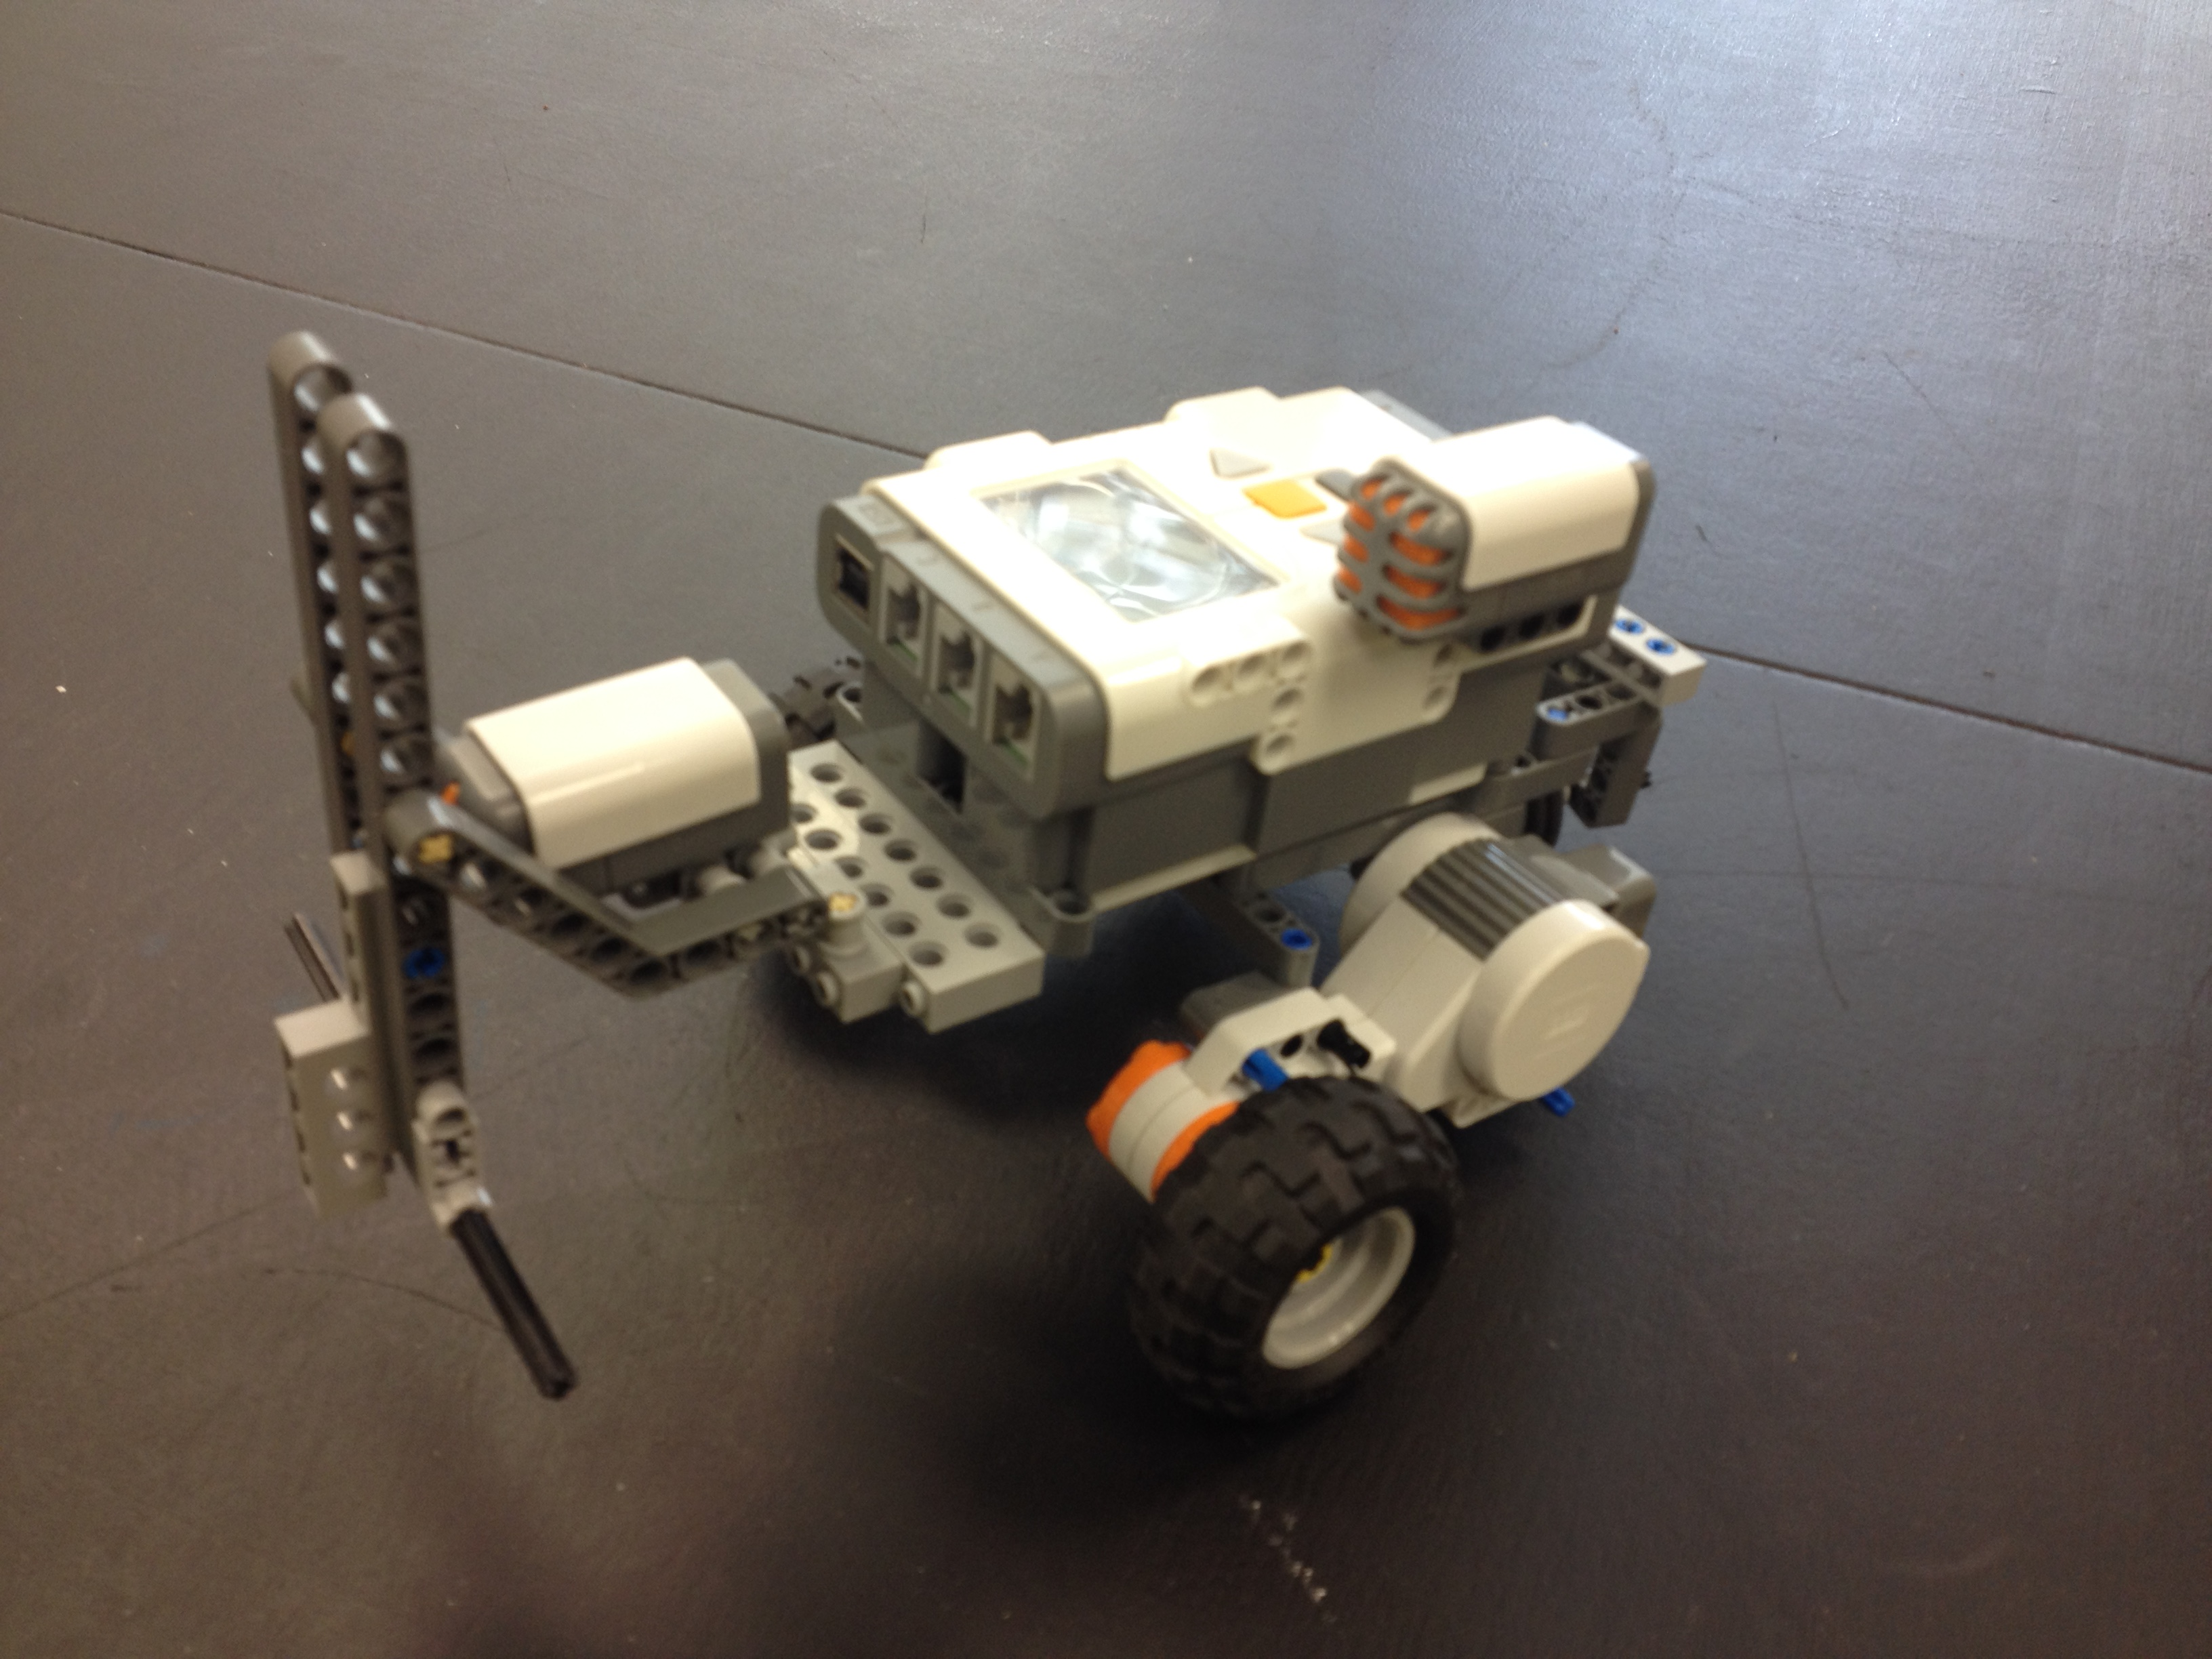
Abstract
Drivebot from lab #2
Attached Sound-sensor
Attached Touch-sensor
Use of LCD display
Use of Motor Commands
(Figure 1 - Taken from Barak’s phone)

Slide 3
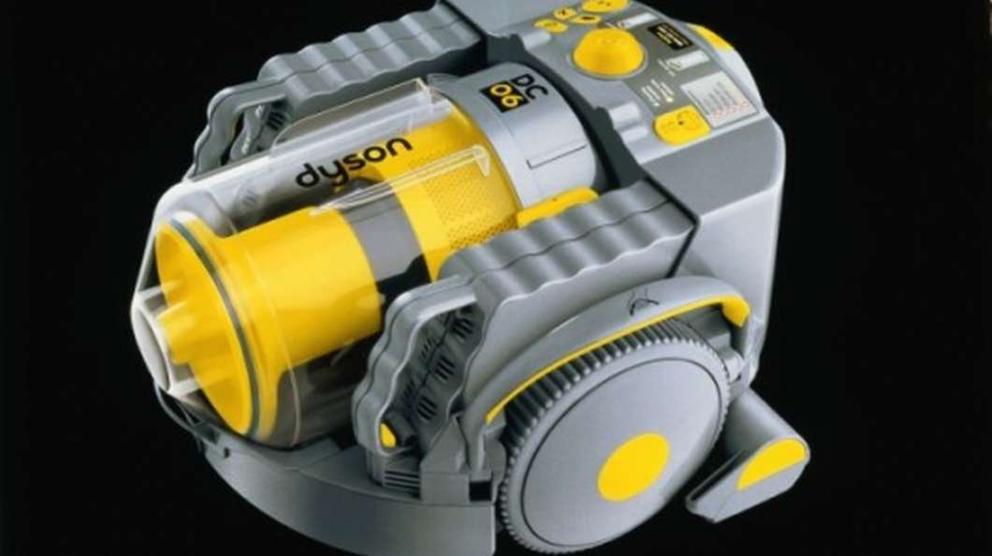
Practical uses
Vacuum
70 Sensors
Learns Layout of room
Does not re-vacuum

Slide 4
introduction
Task #1 Sound-Level
Task #2 Clap Down and Back
Display Sound Levels on LCD
Clears LCD every 100 msec
Hear Clap
Drive Forward (5 sec), Turn 180 degrees,
Return to Start and Turn 180 degrees

Slide 5
Introduction
Task #3 Clap and Go
Task #4 Clap-Bump and Drive
Hear Clap
Drive Forward (5 Sec), Turn 180 degrees, Return to Start
Stop, Turn 180 degrees, Play Tone
Repeat All
Hear Clap
Drive Forward
Touch Sensor pushed
Stop motor, Display crash count, plays tone
Backs up, Stops, Turns random angle, Stops
Repeats everything but hearing clap

Slide 6
Results
Task #1
Used only one conditions for if statements
if ((SensorValue(S1) <= 66)&&(SensorValue(S1) > 33))
Task #2
Was not registering clap
eraseDisplay();
displayTextLine (1, "%d", SensorValue[S1]);
wait1Msec(1000);

Slide 7
Results
Task #3
Instead of turning it was driving forward
nSyncedMotors = synchAC;
nSyncedTurnRatio = 100;
Turn ratio set to -100
Task #4
Bot would not continue after first bump
Added a second while loop in between
if (SensorValue[S1] > 35)
{
while (true)

Slide 8
Conclusion
Remember multiple conditionals need to be used at times
Wait time for program to start to zero out sensor: Wait time command, Set sensor value to zero
Remember to set synch turn ratio negative for turns
Can include a while loop within in a while loop

Slide 9

Questions?

Slide 10
Reference
Figure one Taken from Barak’s phone.
M. Hanlon, “Dyson’s Robot Vacuum Cleaner – the DC06,” Gizmag., 2 June 2004.
D. Parker. (2007) [Online]. Available: http://www.nxtprograms.com/

Slide 11
Appendix
Task 1
#pragma config(Sensor, S1, soundSensor, sensorSoundDB)
task main()
{
while(true)
{
eraseDisplay();
displayTextLine (1, "Sound Level:", SensorValue(S1));
if (SensorValue(S1) <= 33)
{
displayTextLine (2, "Quiet", SensorValue[S1]);
}
if ((SensorValue(S1) <= 66)&&(SensorValue(S1) > 33))
{
displayTextLine (2, "Noisy", SensorValue[S1]);
}
if ((SensorValue(S1) <= 100)&&(SensorValue(S1) > 66))
{
displayTextLine (2, "Loud", SensorValue[S1]);
}
wait1Msec (100); // Delay
}//while
}

Slide 12
Appendix
Task 2
#pragma config(Sensor, S1, soundSensor, sensorSoundDB)
task main()
{
while (true)
{
eraseDisplay();
displayTextLine (1, "%d", SensorValue[S1]);
wait1Msec(1000);
if (SensorValue[S1] > 35)
{
motor[motorA]= 30; // Turn motor A on 50%
motor[motorC]= 30; // Turn Motor C on 50%
wait1Msec (5000); // Delay
bFloatDuringInactiveMotorPWM = false; //motors will brake when power is set to "0"
motor[motorA]= 0; // Turn Motor A off
motor[motorC]= 0; // Turn Motor C off
//for it to turn around exactly 180 degrees, sync motors
motor[motorA]= 30; // Turn motor A on 50% (Turn around)

Slide 13
Appendix
motor[motorC]= -30; // Turn Motor C off
wait1Msec (1600); // Delay
motor[motorA]= 0; // Turn Motor A off
wait1Msec (500); // Delay
motor[motorA]= 30; // Turn motor A on 50%
motor[motorC]= 30; // Turn Motor C on 50%
wait1Msec (5000); // Delay
//for it to turn around exactly 180 degrees, sync motors
motor[motorA]= 30; // Turn motor A on 50% (Turn around)
motor[motorC]= -30; // Turn Motor C off
wait1Msec (1600); // Delay
motor[motorA]= 0; // Turn Motor A off
wait1Msec (500); // Delay
break;
} // end if
} //end while
}

Slide 14
Appendix
Task 3
#pragma config(Sensor, S1, soundSensor, sensorSoundDB)
task main()
{
while (true)
{
eraseDisplay();
displayTextLine (1, "%d", SensorValue[S1]);
wait1Msec(1000);
if (SensorValue[S1] > 35)
{
nSyncedMotors = synchAC;
nSyncedTurnRatio = 100;
motor[motorA]= 30; // Turn motor A on 50%
wait1Msec (5000); // Delay
bFloatDuringInactiveMotorPWM = false; //motors will brake when power is set to "0"
motor[motorA]= 0; // Turn Motor A off
nSyncedTurnRatio = -100;
motor[motorA]= 30; // Turn motor A on 50% (Turn around)
wait1Msec (1600); // Delay

Slide 15
Appendix
motor[motorA]= 0; // Turn Motor A off
wait1Msec (500); // Delay
nSyncedTurnRatio = 100;
motor[motorA]= 30; // Turn motor A on 50%
wait1Msec (5000); // Delay
nSyncedMotors = synchAC;
nSyncedTurnRatio = -100;
motor[motorA]= 30; // Turn motor A on 50% (Turn around)
wait1Msec (1600); // Delay
motor[motorA]= 0; // Turn Motor A off
wait1Msec (500); // Delay
playSound(soundUpwardTones); //Plays the sound "Upward Tones"
wait1Msec (2300); // Delay
} // end if
} //end while
}

Slide 16
Appendix
Task 4
#pragma config(Sensor, S1, soundSensor, sensorSoundDB)
#pragma config(Sensor, S2, touchSensor, sensorTouch)
task main()
{
// In order to fix the sound sensor, and maybe the touch sensor, from reading wrong values at first
//Set a int temp =0;
//wait time then set int temp = SensorValue[S1];
//wait time
// also set if paramenters to react to temp instead of SensorValue
int degrees = 0;
int crash_count = 0;
degrees = rand() % (2800-800) + 800;

Slide 17
Appendix Cont.
while (true)
{
eraseDisplay();
displayTextLine (1, "%d", SensorValue[S1]);
wait1Msec(1000);
if (SensorValue[S1] > 35)
{
while (true)
{
nSyncedMotors = synchAC;
nSyncedTurnRatio = 100;
motor[motorA]= 30; // Turn motor A on 50%
bFloatDuringInactiveMotorPWM = false; //motors will brake when power is set to "0"

Slide 18
Appendix cont.
crash_count++;
displayTextLine (2, "%d", crash_count);
playSound(soundUpwardTones); //Plays the sound "Upward Tones"
motor[motorA]= 0; // Turn Motor A off
wait1Msec (1600); // Delay
motor[motorA]= -50; // Turn motor A on 50% (Turn around)
wait1Msec (1000); // Delay
nSyncedTurnRatio = -100;
motor[motorA]= 30; // Turn motor A on 50% (Turn around)
wait1Msec (degrees); // Delay
motor[motorA]= 0; // Turn Motor A off
wait1Msec (500); // Delay
} //end 2nd if

Slide 19
Appendix Cont.
} //end 2nd while
} // end 1st if
} //end 1st while

